Slide 1
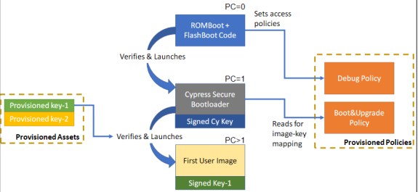
Embedded Security Showcase on PSOC6 (ESSOP)
27.04.20
Team Meeting – Week 1
Aadarsh Kumar Singh , 766499
Hari Krishna Yelchuri , 766518
Vaishnavi Sankaranarayanan , 766486

Slide 2
Content
  Minutes of Meeting – 20.4.2020 -
  User Story 1- Analysis for the open item list requirements
  User Story 2- Create List of all open requirements
  User Story 3- Create Quick Start guide for PSoC6
  User Story 4- Analyze the capablities of the PSOC 6 Board
  Clarification Required
H_DA Embedded Systems and Microelectronics

Slide 3
Analysis for the open item list requirements
User story link : https://aadarsh.atlassian.net/browse/ESSOP-5
Show Demo :
  OIL-1
  OIL-2
  OIL-3
  OIL-4
Pending for review
H_DA Embedded Systems and Microelectronics

Slide 4
Create List of all open requirements
User story link : https://aadarsh.atlassian.net/browse/ESSOP-3
Listed Open Requirements in the location in the repo:
  10_Projectmanagement\30_OpenItems\SYS_OIL_TO_CYPRESS
Pending for review
H_DA Embedded Systems and Microelectronics

Slide 5
Create Quick Start guide for PSoC6
User Story link : https://aadarsh.atlassian.net/browse/ESSOP-2
Location in the repo : 40_Implementation\PSOC6\trial
Note : Committed in the trials , because it needs to be updated after the OIL to Cypress is resolved.
H_DA Embedded Systems and Microelectronics

Slide 6
Analyze the capablities of the PSOC 6 Board.
User story link : https://aadarsh.atlassian.net/browse/ESSOP-4
Due to critical open item lists , we have not been able to completely realize the capabilities of the board.
Hence this user story is still in backlog.
H_DA Embedded Systems and Microelectronics

Slide 7
Clarifications Needed
Answers for the open item list.
Embedded security showcase use case finalization.
    The problem with this is we are not able to test any features or examples on the board.
    Requires some guidance regarding the trending use case for the Embedded Security Showcase , We are interested to do a use case for automotive or IoT sector.
H_DA Embedded Systems and Microelectronics

